Slide 1
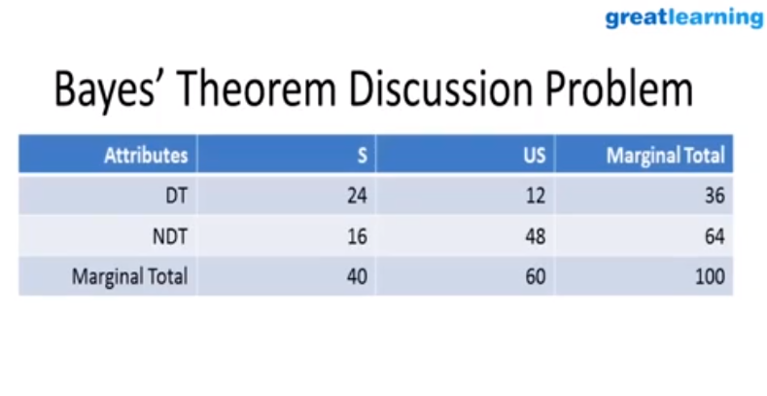
P(S/DT) = 24/36 = 0.67

